Slide 1
CSE 573 – Computer Vision and Image Processing Project
Sreeram Melpadi Piyush Gulhane Thushar Thorenur Govindaraju
12 Aug 2025

Slide 2
Emoji Generation
Using Generative Adversarial Networks (GANs)

Slide 3
Project Description
In this project, we aim to develop a simple generative model that can generate Smiley-faced emojis.
We trained a Deep Convolutional Generative Adversarial Network (DC-GAN) that can learn to generate the emojis like the original Sample space.

Slide 4
Dataset

Slide 5
Dataset Details
The Dataset we chose for this project is the “OpenMoji” Dataset.
It is an open-source dataset with 4000+ emojis.
But for the scope of this project, we have picked only the Round Smiley faces as the data source since they are similar looking and each one has distinct features.

Slide 6





Samples
Type | Detail
Dataset | OpenMoji
Category | Smileys
Dataset Length | 108
Format | PNG
Dimension | 128x128x3
Background | Black

Slide 7
Model Architecture

Slide 8
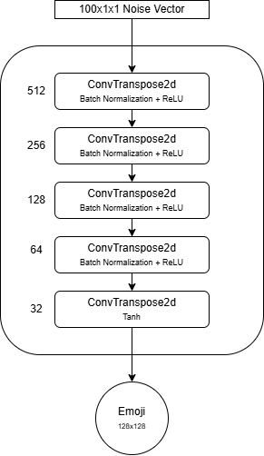
DC-GAN: Generator
Type | Detail
Input Vector Dim | 100x1x1
Output Dim | 128x128x3
Kernel Size | 4x4
Upsampling Layers | 5
Batch Normalization | Yes
Activation | ReLU (Tanh output)

Slide 9
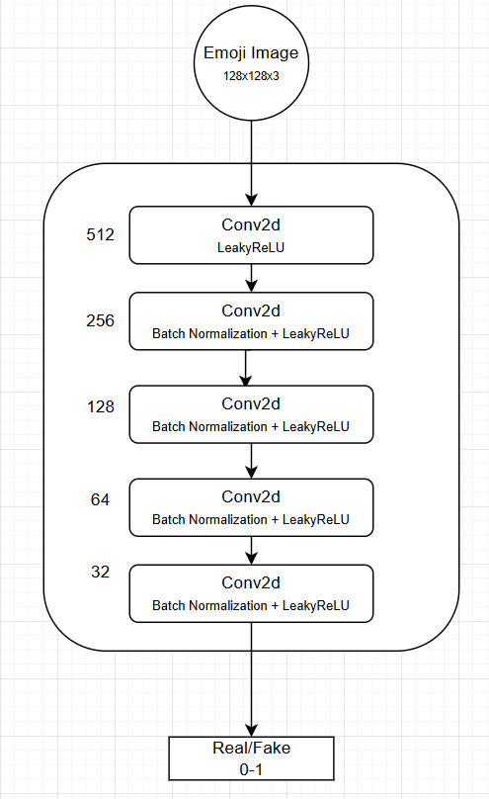
DC-GAN: Discriminator
Type | Detail
Input Dim | 128x128x3
Output Dim | 1 (0.0 - 1.0)
Conv2d Layers | 5
Kernel Size | 4x4
Batch Normalization | Yes
Activation | LeakyReLU (Sigmoid output)

Slide 10
Training

Slide 11
Training
We had to ensure that the discriminator learns slower than the generator to make sure the gradients to the generator aren’t lost due to a very good discriminator.
We tried various learning rate combinations to ensure that the training is good and the generator is able to learn to generate good samples.
We used the Binary Cross Entropy Loss on the Discriminator.

Slide 12
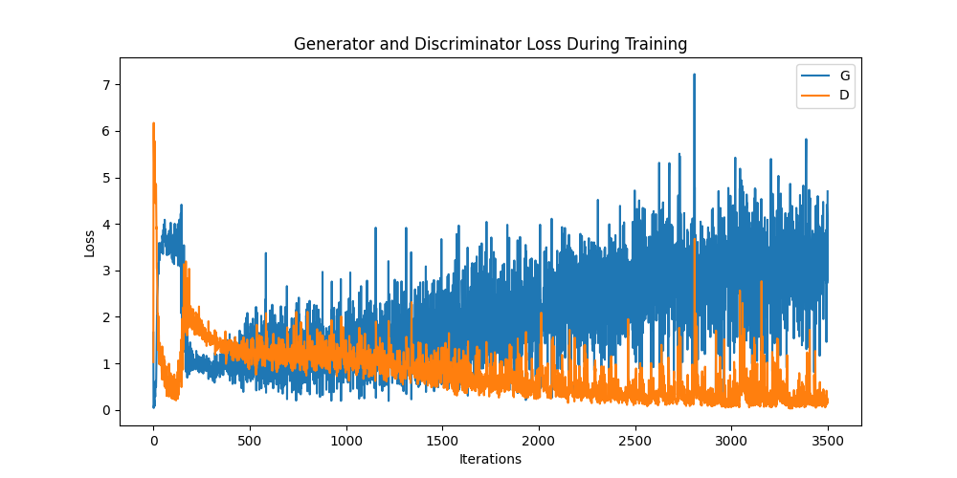
Training
Type | Detail
Epochs | 500
Batch Size | 8
Loss Fn | BCELoss
Optimizer | Adam
Learning rate | 1.5e-4 (G) 1.0e-4 (D)

Slide 13
Results and metrics

Slide 14
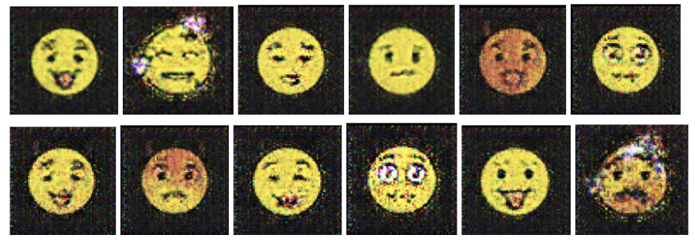
Generations

Slide 15
Metrics

Slide 16
deMO

Slide 17
Thank you

